Slide 1
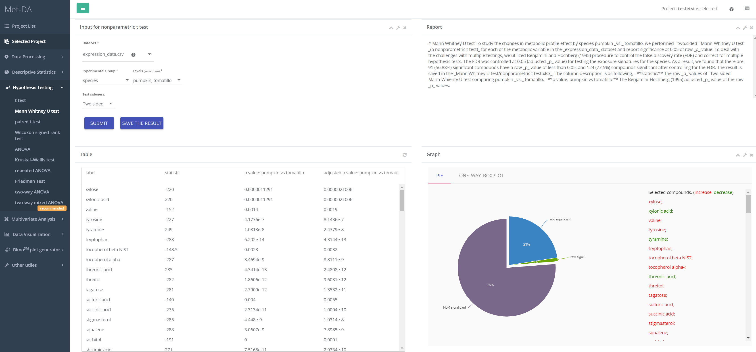
1
4
3
2

Slide 2
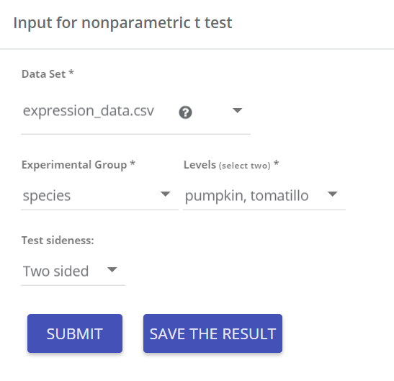
Input parameters
Data matrix for Mann-Whitney U test
Select two groups you would like to test
Test either pumpkin ≠ tomatillo , or pumpkin < tomatillo , or pumpkin > tomatillo
1

Slide 3
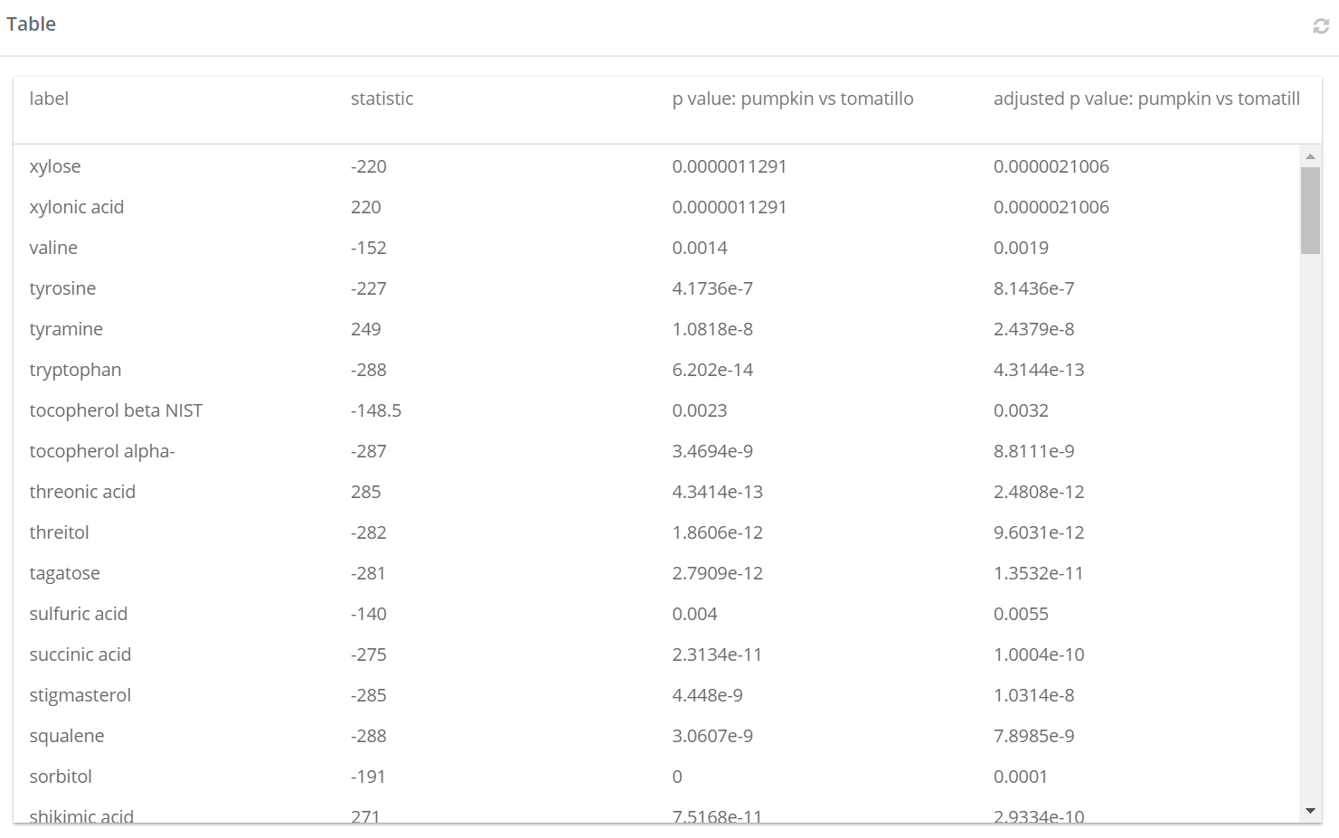
Result table
Click to refresh the table
statistic:
Positive value means the average of value of pumpkin is larger than the tomatillo.
Negative value means the average of value of pumpkin is less than the tomatillo.
p value: pumpkin vs tomatillo:
p value of Mann-Whitney U test
2
adjusted p value: pumpkin vs tomatillo:
p value of Mann-Whitney U adjusted for false discovery rate using Bonjamini-Hochberg correction. Adjusted p value is always larger than the p value.

Slide 4
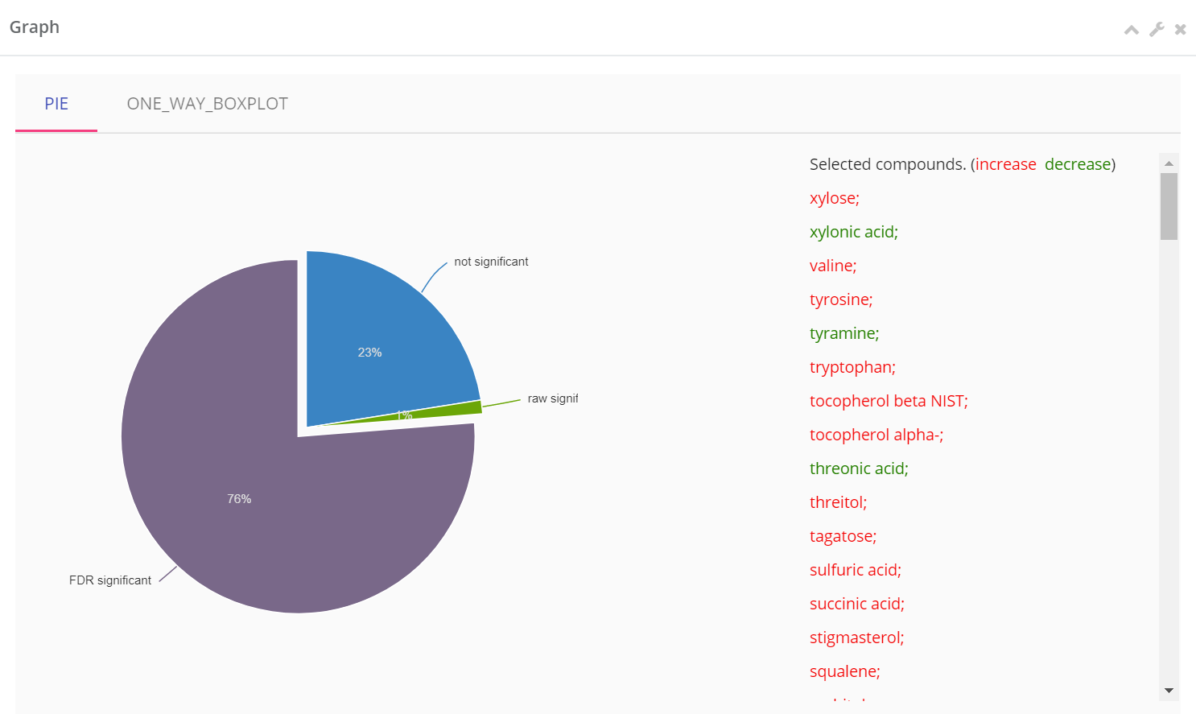
Visualizing the significant percentage
Pie chart visualization of the percentage of significant compounds.
Not significant: p value > 0.05
Raw significant: p value < 0.05 but adjusted p value > 0.05
FDR significant: adjusted p value < 0.05
Click arc to display the compound names in each arc. increase means pumpkin is larger than tomatillo.
3

Slide 5
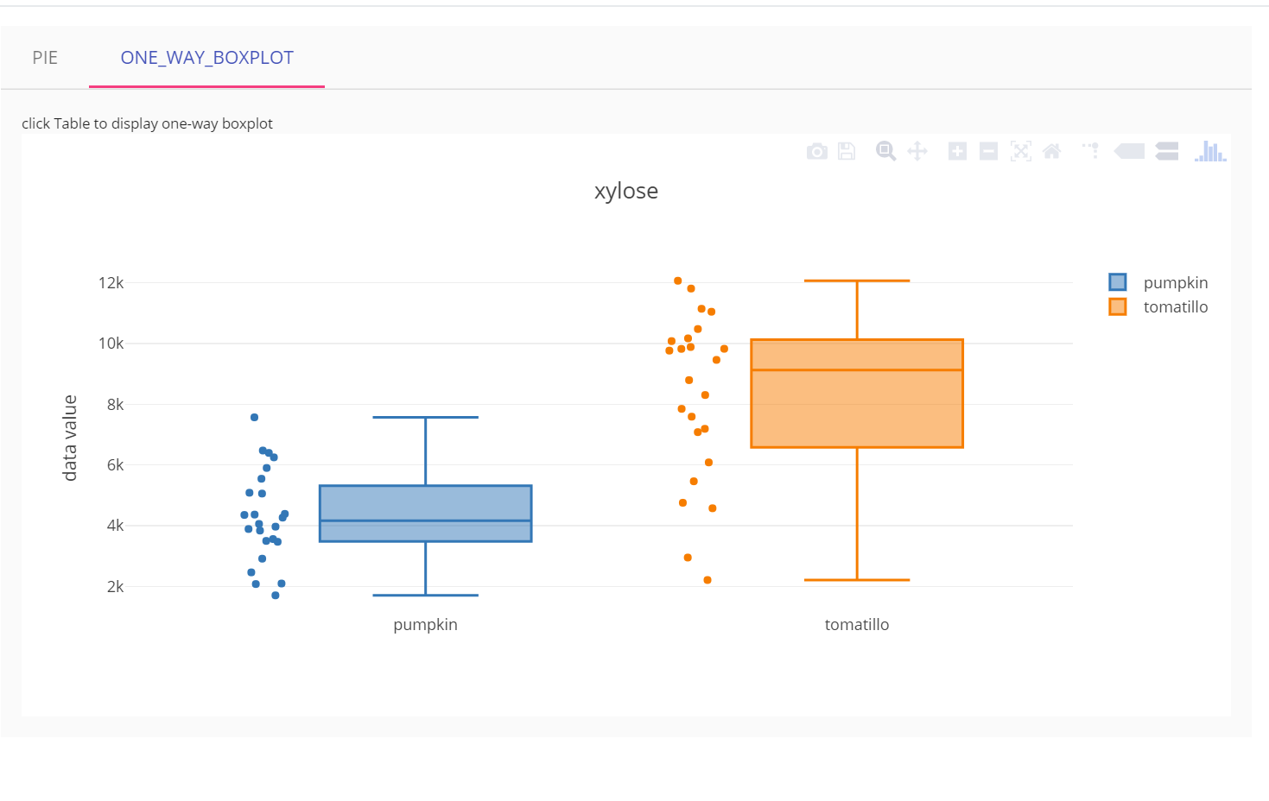
Visualizing each compound using boxplot
Click result table row to visualize each compound by boxplot.
Scatters next to boxplots are the sample values.
Boxplots for all the compounds can be generated/saved in Visualization->Boxplot.
4

